Slide 1
ETL service
Task 5

Slide 2
Product description
ETL service for private data cleansing Data quality and availability is important for applications running in the framework. The framework defines so-called data modules stored on S3 or in a RDBMS. A data module is described by a json-ld compatible metadata, a collection protocol and the versioned data. The ETL service would extract data from internal corporate systems, cleanse, merge, anonymize, transform the data and upload it to a new version of a data module. Then the module can be used by machine learning applications deployed on the framework.
Team: Anoshenko Daniil, Rogoza Kirill, Sergey Rogachev, Pham Manh, Denune Pravira
Repo: https://github.com/Neovodoo/ETL
Report: a link to this slides within project repo/doc storage

Slide 3
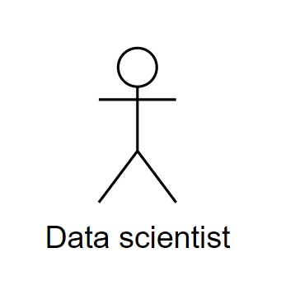


Use case diagram
Key use cases:
Interaction with ETL jobs
Permission dependency
Interaction with Datasets
Service integration
Service configuration
Permission management
Logs
Summary reports
Notes:
Identify actors and use cases and develop a use case diagram from prior business requirements
Rule of thumb: user/job story = function / user level use case
Actors - user groups and/or external systems that have similar interaction goals (use cases)

Slide 4
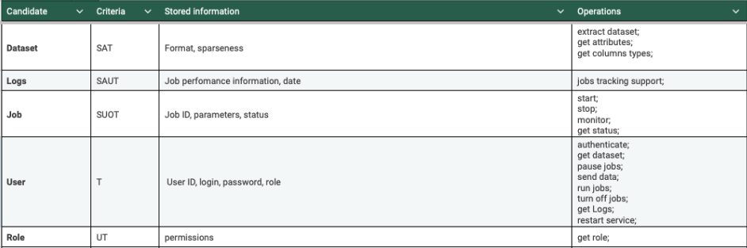
Class candidates (ETL Service for MLOps framework)
Full table is at github repository at task5 folder
Notes:
Quick notation
– S : stores information
– I : has interface to to change stored information;
– A : information has structure;
– O : interface has several operations
– U : attributes and operations are shared by all instances (universal);
– T : essential for complete/well-formed model

Slide 5
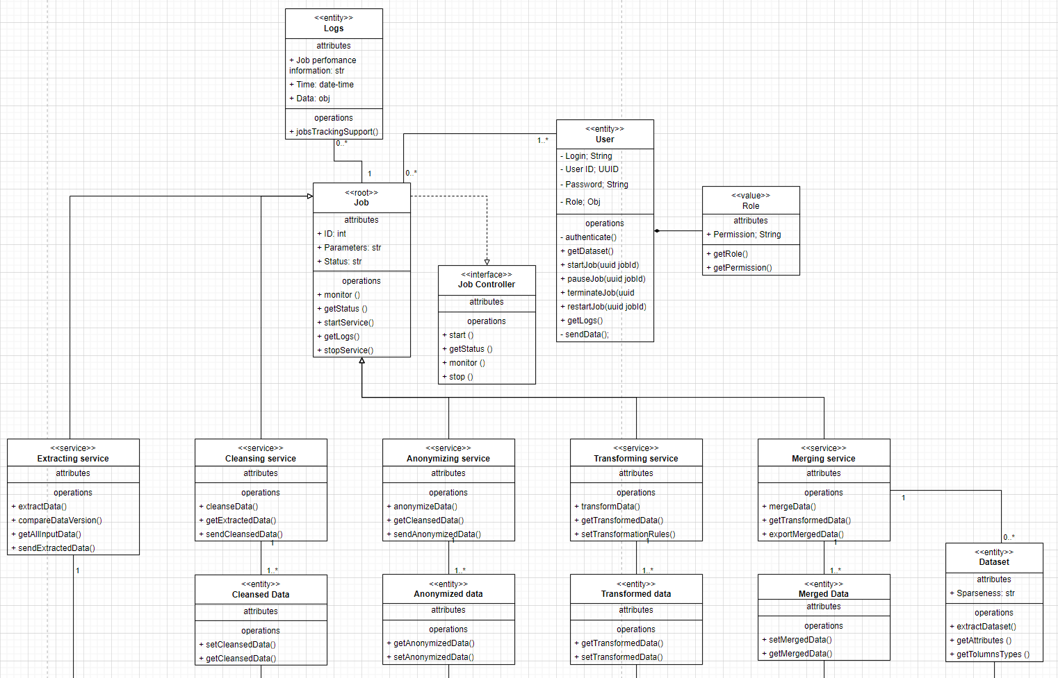
Domain model diagram

